Slide 1
Management strategy evaluation

Slide 2

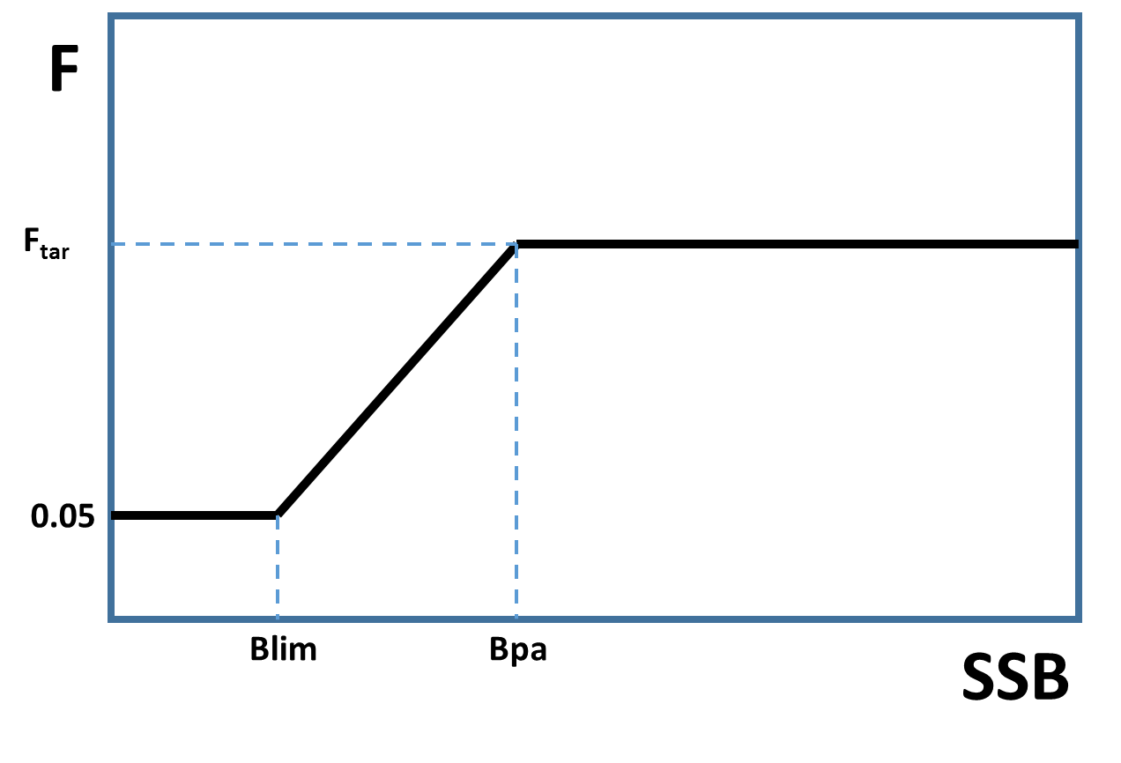
Why carrying out an MSE
ICES provides advice based on the MSY advice rule by default
But managers may want different management rules :
Different shape for the HCR
Applying limits in year to year
TAC differences
Being allowed to bank and
borrow quota
Take account of species interaction
or mixing of con-specific stocks
managers send a request to ICES
ICES workshop -> drafting group -> ACOM -> advice

Slide 3

Principle
Carry out long-term stochastic simulations (similar to EQsim) implementing the management strategy to be evaluated
Derive a number of indicators to evaluate management performance
Simulations must be based on the current perception of the stock, give an appropriate representation of the different sources of variability and uncertainty in the stock and in the management system

Slide 4
Simulation design

Slide 5
Starting conditions : what do we know about the current state?
Most assessment models provide uncertainty estimates for the estimated parameters and estimated quantities (N and F@age, SSB etc...)
To give a fair representation of what we know about the current state of the stock, the starting conditions of the simulation must reflect these uncertainties
We use the parameters variance/covariance matrix to resample Nits sets of parameters, and corresponding stock estimates

Slide 6
Starting conditions : what do we know about the current state?

Slide 7
Operating model
Stock recruitment :
Different approaches possible
If there seem to be a link between recruitment and SSB,
Can use the SR model giving the best fit
Can use the model combination approach (as in Eqsim)
If the stock recruitment link is poorly defined
Usually use a segmented regression model
Consider temporal autocorrelations
Fit model separately for each replicate of the stock

Slide 8
Operating model
biology

Slide 9
Operating model
Fisheries selection

Slide 10
Assessment error
Assessment in the loop
Short cut approach
True stock (operating model)
Generate observations, ie.e survey indices, catch at age (Observation error model)
Run the assessment model
Perceived stock
True stock (operating model)
Error matrices (on N@age and F@age)
Perceived stock
Benchmark assessment
Description of the error structure (based on model uncertainty, retrospective pattern, historic performance of short term forecast

Slide 11
Assessment error - F
Compare F as estimated in year y at the time (i.e. forecasted in annual assessments from year y-1 ) with F as estimated now (best estimate)
Deviation calculated as log difference
Standard deviation of these log deviations gives the marginal distribution (σ_{m}).
Autocorrelation of AR(1) process also calculated (Fphi)
The conditional standard deviation, Fcv, is calculated as σ_{m} (1- Fphi ²) ⁻²

Slide 12
Implementing management

Slide 13
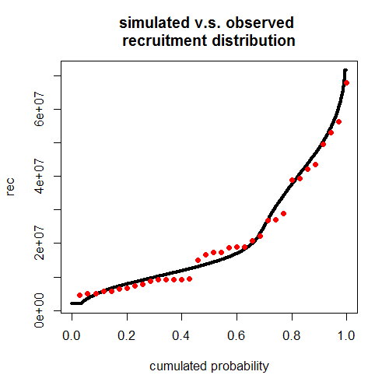
Check the model
Impose future F values with similar characteristics as the historical ones, and check that the stock reaction is similar to past variations

Slide 14
Check the model
Impose future F values with similar characteristics as the historical ones, and check that the stock reaction is similar to past variations

Slide 15
Run simulation and analyse the outcome
What is the appropriate number of replicates?

Slide 16
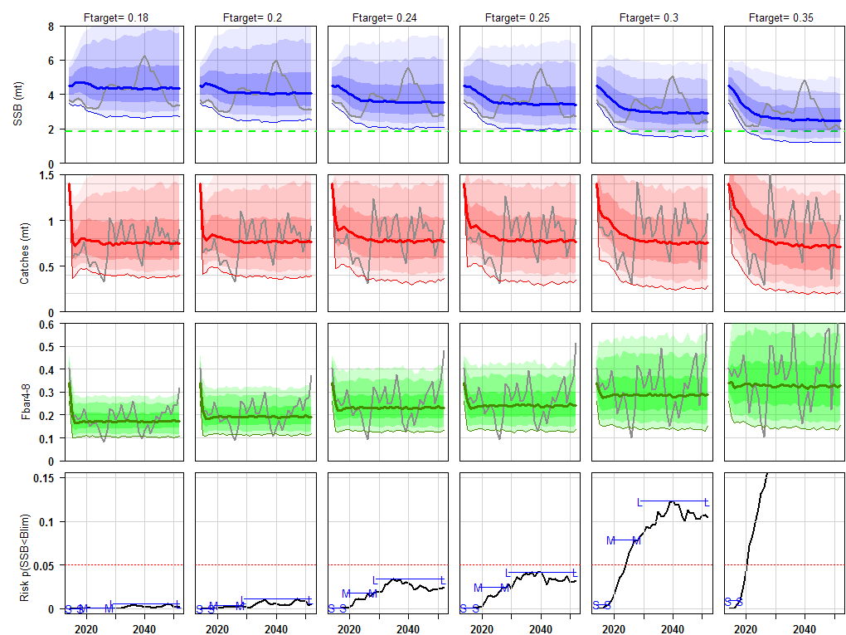
Run simulation and analyse the outcome
Average SSB
Average catches/landings
Catches variability
Average realised F
Risk to fall below Blim

Slide 17
Run simulation and analyse the outcome
Runs without constraint on TAC variability
Not precautionary
precautionary
Long term yields
Not precautionary
Yields variability
precautionary

Slide 18
Run simulation and analyse the outcome
Runs with constraint on TAC variability
Not precautionary
precautionary
Long term yields
Not precautionary
Yields variability
precautionary

Slide 19
Exercise
Eqsim software has been modified to run a simple MSE
NOTE : all replicates have same starting conditions
Use it on our stock to test different combinations of Btrigger and Ftarget.
What are the tradeoffs, which management options seem the most interesting?

